Slide 1
What is Drag and Drop Action?
This is an action performed with a mouse when a user moves (drags) a web element and then places (drops) it into an alternate area.
E.g. This is a very common action used in Windows Explorer while moving any file from one folder to another. Here, the user selects any file in the folder, drags it to the desired folder and just drops it.
To perform the drag-drop action through a Selenium script, there is no direct drag-drop method available in WebElement interface. Unlike other commands like click(), sendKeys() there is nothing available for drag and drop. Here, we leverage the Actions class which provides various methods of emulating such complex interactions.
So, here are the methods Actions class provides for Drag-Drop action:
dragAndDrop(WebElement source, WebElement target)
dragAndDropBy(WebElementsource, int xOffset, int yOffset)

Slide 2
dragAndDrop(WebElement source, WebElement target): This method performs left click, hold the click to hold the source element, moves to the location of the target element and then releases the mouse click.
First, instantiate an Actions class:
Actions actions = new Actions(driver);
As you can see, the dragAndDrop(WebElement source, WebElement target) method has two arguments to pass. One is a source web element and another is target web element. This source web element is any web element that needs to be dragged. Target web element is any web element on which dragged object needs to be placed or dropped. To find the source and target element use the below command:
WebElement source = driver.findElement(Any By strategy & locator);
WebElement target = driver.findElement(Any By strategy & locator);

Slide 3
Now, when we have got the actions class object and the element as well, just invoke perform() method for the drag & drop:
actions.dragAndDrop(source, target).perform();
Let’s see what happens internally when invoke the perform() method above:
Click And Hold Action: dragAndDrop() method first performs click-and-hold at the location of the source element
Move Mouse Action: Then source element gets moved to the location of the target element
Button Release Action: Finally, it releases the mouse
Build: build() method is used to generate a composite action containing all actions. But if you observe, we have not invoked it in our above command. The build is executed in the perform method internally
Perform: perform() method performs the actions we have specified. But before that, it internally invokes build() method first. After the build, the action is performed

Slide 4
Use below link for drag and drop action http://demo.guru99.com/test/drag_drop.html
driver.get("http://demo.guru99.com/test/drag_drop.html");
JavascriptExecutor js = (JavascriptExecutor) driver;
js.executeScript("window.scrollBy(0,100)");
//Element which needs to drag.
WebElement From=driver.findElement(By.xpath("//*[@id='credit2']/a"));
//Element on which need to drop.
WebElement To=driver.findElement(By.xpath("//*[@id='bank']/li"));
//Using Action class for drag and drop.
Actions act=new Actions(driver);
//Dragged and dropped.
act.dragAndDrop(From, To).build().perform();
Thread.sleep(20000);

Slide 5
Example -2
driver.get("http://demo.guru99.com/test/drag_drop.html");
//Element(BANK) which need to drag.
WebElement From=driver.findElement(By.xpath("//*[@id='credit2']/a"));
//Element(DEBIT SIDE) on which need to drop.
WebElement To=driver.findElement(By.xpath("//*[@id='bank']/li"));
//Using Action class for drag and drop.
Actions act=new Actions(driver);
//BANK drag and drop.
act.dragAndDrop(From, To).build().perform();
//Verifying the Perfect! message.
if(driver.findElement(By.xpath("//a[contains(text(),'Perfect')]")).isDisplayed())
{
System.out.println("Perfect Displayed !!!");
}
else
{
System.out.println("Perfect not Displayed !!!");
}

Slide 6
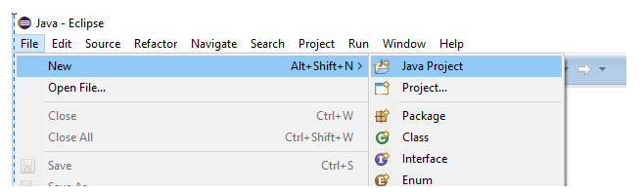
Create TestNG Project In Eclipse
First of all, you will need to launch Eclipse and then follow the steps below to create a new TestNG project.
Step 1: Navigate to File > New > Java Project.

Slide 7
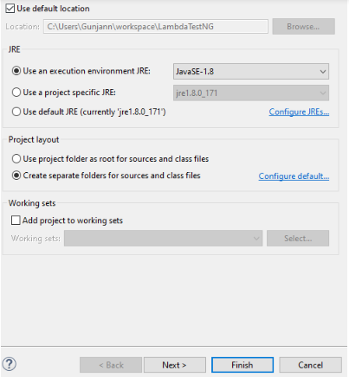
Step 2: Give your project a name for example, ‘LambdaTestNG’ and click on Next.

Slide 8
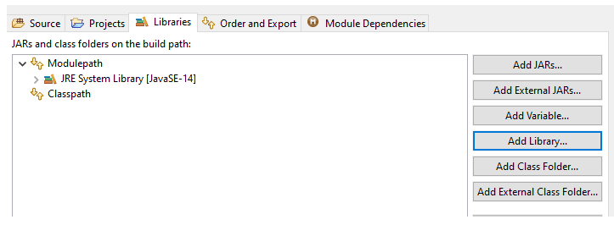
Step 3: On the next screen, you will see the Java settings for your new project. To make it a TestNG project just navigate to the Libraries tab and click on the Add Library button.

Slide 9
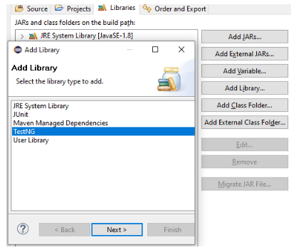
Step 4: Choose TestNG from the list of libraries and click Next.

Slide 10
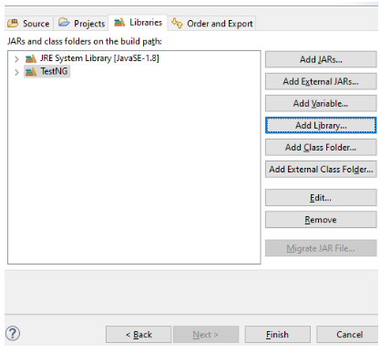
Step 5: Now, you will see TestNG added to your project libraries. Click on Finish and you are all set with your testNG project.

Slide 11
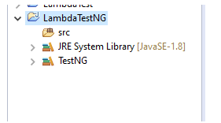
Your Java project has been created successfully and you will be able to see it by clicking on the Package Explorer button on the left panel.

Slide 12
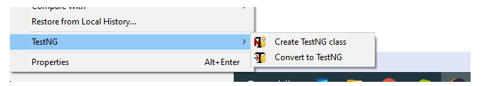
Creating a TestNG class in Eclipse
Step 1: Navigate to src from the project folder and right-click the same. You will see TestNG as an option in the dropdown towards the bottom. Click on it and you will now see two sub-options to either create a TestNG class or convert the class to TestNG. As we are creating a new TestNG class, you need to select the first option.

Slide 13
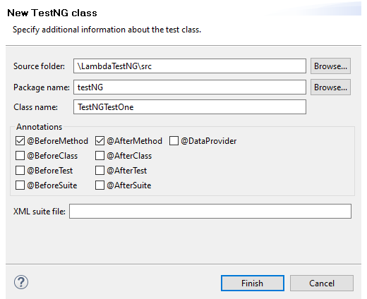
Step 2: Generally, the source folder name is auto-filled but if it is not, you can simply browse through the same. Next, you can give any name to your class, for example, ‘TestNGTestOne’ and its package. For now, we will keep the basic annotations selected @BeforeMethod and @AfterMethod. However, Annotations can be configured at a later stage as well depending upon your test scenario. If you wish to configure them now, you can refer to the TestNG annotations tutorial.

Slide 14
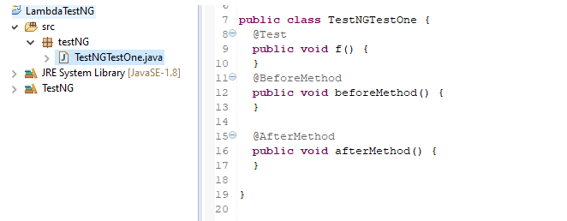
Step 3: You will now see a class(TestNGTestOne.java) in your project directory with default methods, viz f(), as well as beforeMethod() and afterMethod() that you can see were checked in the screenshot above.

Slide 15
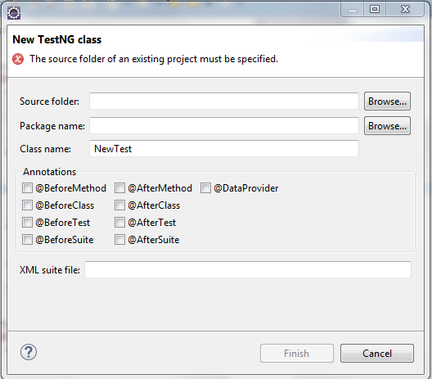

Slide 16
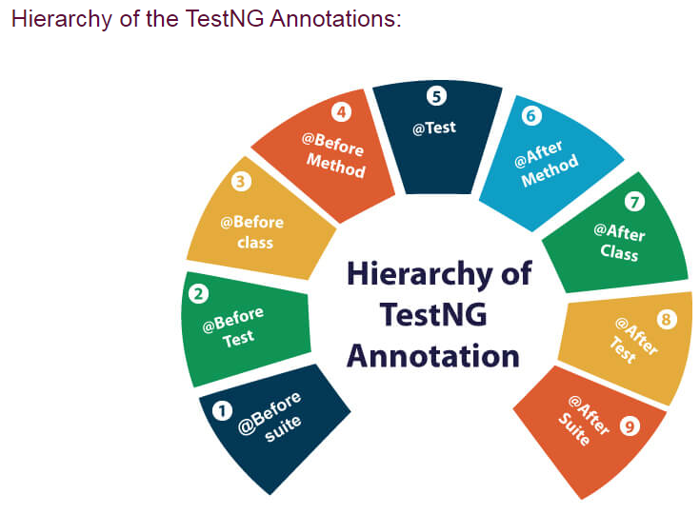

Slide 17
TestNG code without Priority in Alphabetical Order
If we don’t mention any priority, testing will execute the @Test methods based on alphabetical order of their method names irrespective of their place of implementation in the code.
@Test
public void c_method()
{
System.out.println("I'm in method C");
}
@Test
public void b_method()
{
System.out.println("I'm in method B");
}
@Test public void a_method()
{
System.out.println("I'm in method A");
}
@Test public void e_method()
{
System.out.println("I'm in method E");
}
@Test public void d_method()
{
System.out.println("I'm in method D");
}

Slide 18
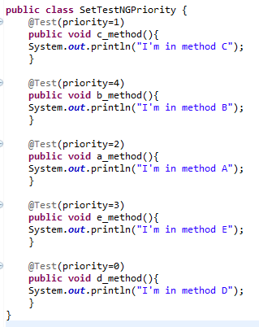
How to set Priority in TestNG

